Slide 1
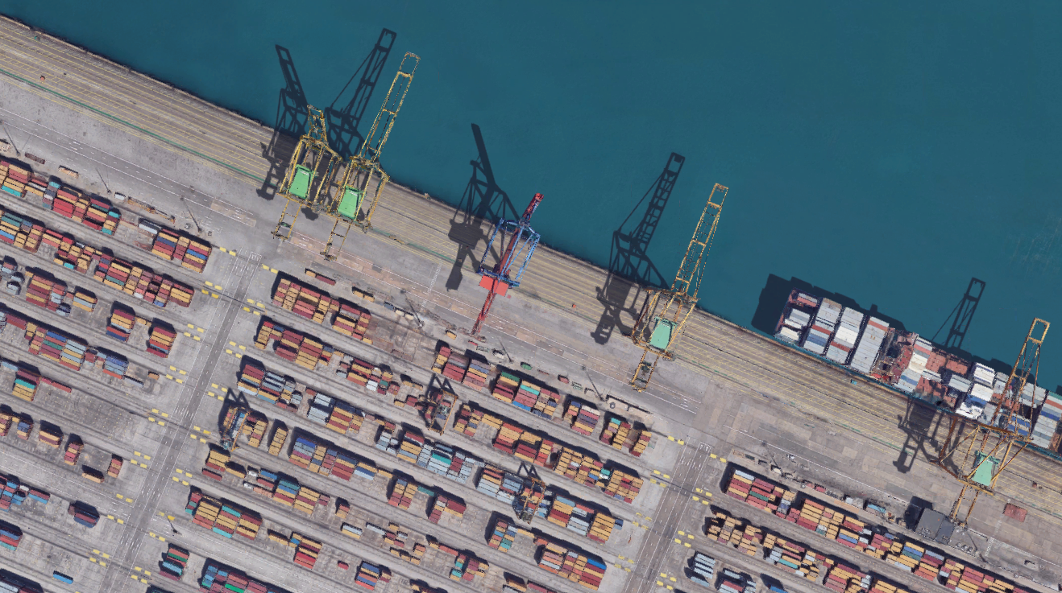
Workshop api Status
Marseille 8th october 2018

Slide 2
Definition proposal
Container Status :
Physical movement of a container characterized by an intermediate reloading or transhipment. As an example, loading and unloading on/off a truck is a move, whereas successive starts/stops of that same truck are not qualified as moves.
Change of status of the asset when not moving. (stuffing, unstuffing, reefer power on , PTI, customs clearance ?, …)
Scope of moves to be considered for the API workshop : all statuses from the release of an empty container from the depot to the return of that same container empty again to a depot, or all moves during container life cycle.

Slide 3
Container Life cycle
Stuffing at client site
Place of loading
Place of unloading
Unstuffing at client site
Empty container available

Slide 4
Why standardize and share the status ?
Provide transparency on ATA, ATD, tracking
Anticipate actions on unexpected events during container journey (change of PTS, delay, technical alarms, …)
Optimize lead-time, vessels management
Reduce costs

Slide 5
How standardize and share the status ?
Gather and share inputs from all actors of the supply chain
Define a common reference during the container life cycle (purchase order, bill of lading, booking number, container (asset) number, …)
Common referential on the moves and all data to define them (i.e. zones of interests UN/Locode, roles location, …)
Manage access to data (how, who and what)

Slide 6
Main tracking statuses during a container trip plan
STATUS CODE | STATUS LABEL | EDI message
MOS | Deliver Empty to shipper | IFTSTA
XRX | Ready to Load at Port Full | IFTSTA
XOF | Load On Board Full | IFTSTA
TDF | Transhipment discharge Full | IFTSTA
TOF | Transhipment Load On Board Full | IFTSTA
IDF | Discharged Full | IFTSTA
IFC | Full To Consignee | IFTSTA
MEA | Empty in depot available | IFTSTA

Slide 7
What is happening between 2 tracking statuses
Between MOS (deliver empty to shipper) and XRX (ready to load at port full)
Arrival at stuffing site
Stuffing of the cargo
Sealing of the doors
…

Slide 8
How to qualify status ?
Description (code) - mandatory
Timestamp UTC - mandatory
Position – optional
Position timestamp
Vehicle reference
Vehicle type
Locode - optional
Source
Full/empty
Import/export
Mode of transport
Actual/estimated
Reliability
…
…

Slide 9
Example: POL
FULL NAME DESCRIPTION | Role - ZOI Definition | Data_Type | Responsibility | Criticality | Reliability / accuracy | Risks | Data_Source
Gate in Full Estimated at Port Of Loading - source Transport Organizer | Port Of Loading | Arrival event - Estimated Time |  |  |  |  | Transport Organizer
Gate in Full Estimated at Port Of Loading - source Inland carrier | Port Of Loading | Arrival event - Estimated Time |  |  |  |  | Inland carrier
Gate in Full Actual at Port Of Loading - source Shipping Line | Port Of Loading | Arrival event - Actual Time |  |  |  |  | Shipping Line
Gate in Full Actual at Port Of Loading - source Terminal-Port | Port Of Loading | Arrival event - Actual Time |  |  |  |  | Terminal-Port
Estimated Arrival deviation at Port Of Loading - source TRAXENS Device | Port Of Loading | Arrival - Delay |  |  |  |  | TRAXENS Device
Estimated Arrival deviation at Port Of Loading - source TRAXENS Platform | Port Of Loading | Arrival - Delay |  |  |  |  | TRAXENS Platform
ATA at Port Of Loading - source Terminal-Port | Port Of Loading | Arrival event - Actual Time |  |  |  |  | Terminal-Port
ATA at Port Of Loading - source TRAXENS Device | Port Of Loading | Arrival - Geofence In |  |  |  |  | TRAXENS Device
ATA at Port Of Loading - source TRAXENS Platform | Port Of Loading | Arrival - Geofence In |  |  |  |  | TRAXENS Platform
ATA deviation at Port Of Loading - source TRAXENS Device | Port Of Loading | Arrival - Deviation - Late |  |  |  |  | TRAXENS Device
ATA deviation at Port Of Loading - source TRAXENS Platform | Port Of Loading | Arrival - Deviation - Late |  |  |  |  | TRAXENS Platform
Load on Vessel Estimated at Port Of Loading - source Shipping Line | Port Of Loading | Loading event - Estimated Time |  |  |  |  | Shipping Line
Load on Vessel Actual at Port Of Loading - source Shipping Line | Port Of Loading | Loading event - Actual Time |  |  |  |  | Shipping Line
Loaded Actual at Port Of Loading - source Terminal-Port | Port Of Loading | Loading event - Actual Time |  |  |  |  | Terminal-Port
Loading movement signature at Port Of Loading - source TRAXENS Device | Port Of Loading | Loading movement signature |  |  |  |  | TRAXENS Device
Loading movement signature at Port Of Loading - source TRAXENS Platform | Port Of Loading | Loading movement signature |  |  |  |  | TRAXENS Platform
Load on Vessel Certified at Port Of Loading - source TRAXENS Platform | Port Of Loading | Loading event - Certified |  |  |  |  | TRAXENS Platform
Vessel ETD at Port Of Loading - source Shipping Line | Port Of Loading | Departure event - Estimated Time |  |  |  |  | Shipping Line
………..

